Slide 1
Invisible Sensing of Vehicle Steering with Smartphones
Dongyao Chen, Kyong-Tak Cho,
Sihui Han, Zhizhuo Jin, Kang G. Shin

Slide 2
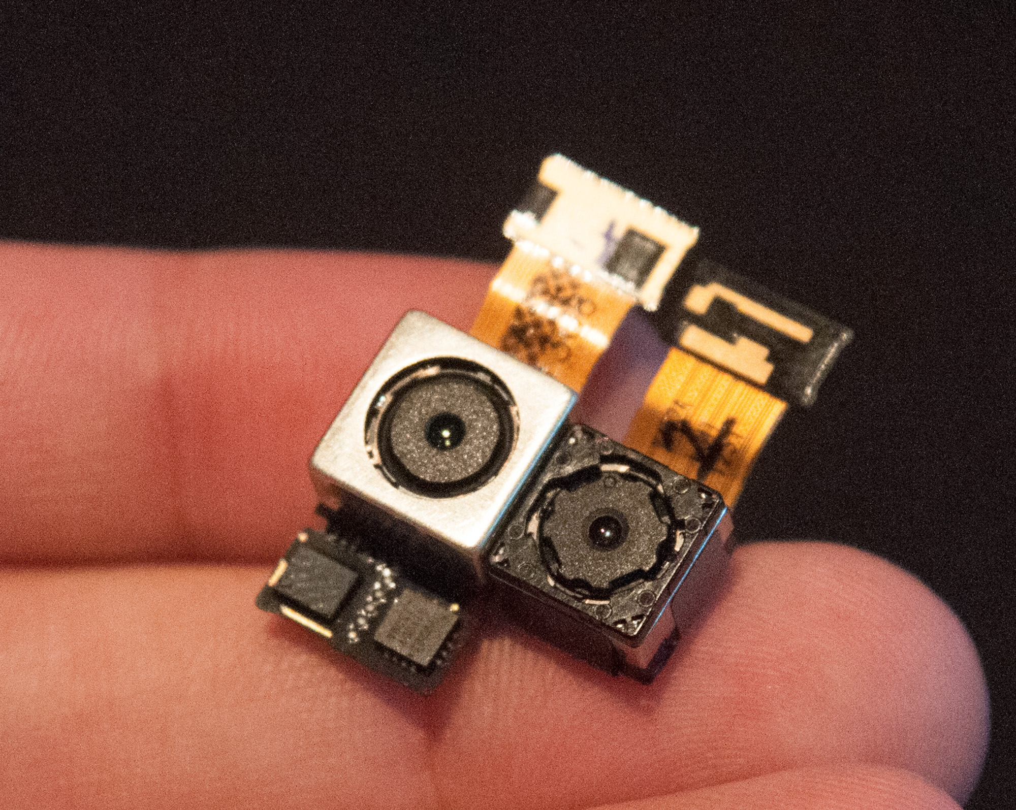
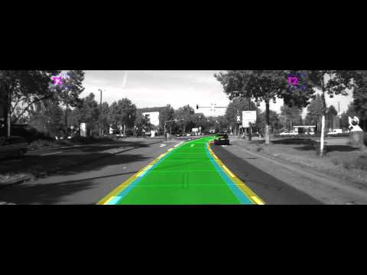
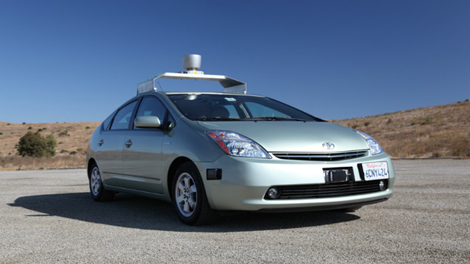
Motivation
Lane marker detection
For lane departure warning system
Detect car maneuvers
Camera is useful in many applications
Autonomous vehicle
Detect lane markers
Detect pedestrians and objects on road
1
Notes:
Even autonomous car is considering use the camera to survilliant the lane marker.

Slide 3
Motivation
Lane marker detection
For departure warning system
Detect car maneuvers
Seeing is believing
Camera is widely used in driving assistant systems
Seeing is Believing
Autonomous vehicle
Detect lane markers
Detect pedestrians and objects on road
1
Notes:
Even autonomous car is considering use the camera to survilliant the lane marker.

Slide 4

Motivation
Does camera always work?

Slide 5
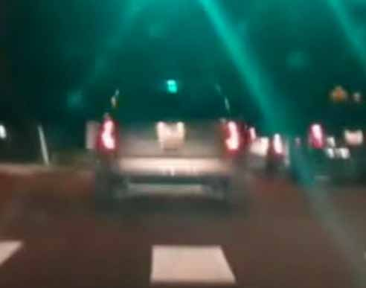
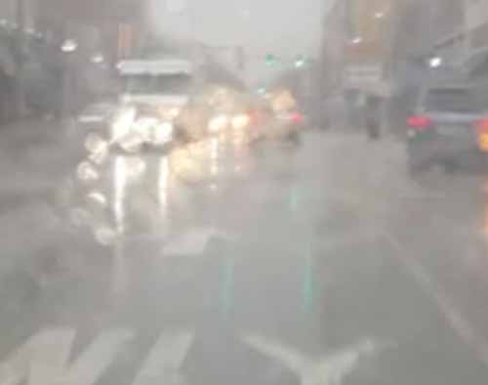
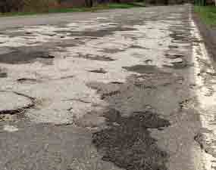
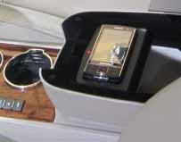
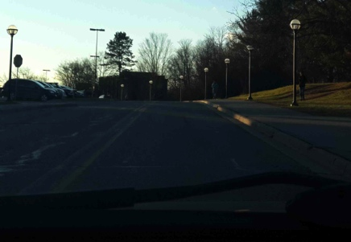
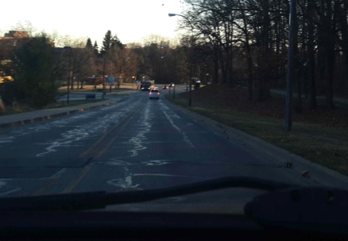
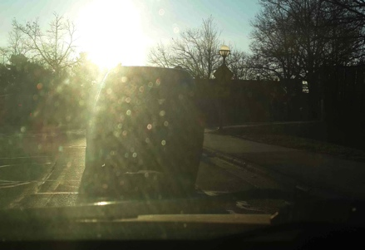
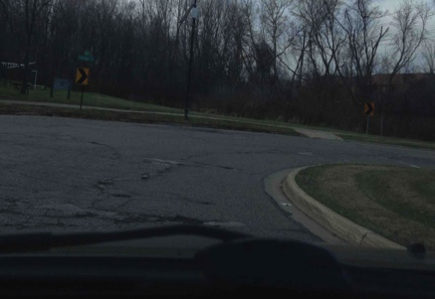
Performance of Camera
Lighting
Weather
Pavement
Placement
Heavy Shadow
No Lane
Sunlight Reflection
Sharp Turn
4

Slide 6
Performance of Camera
Visibility of road objects can be easily distorted
Camera is not reliable for in-car purpose
Lighting
Weather
Pavement
Placement
Heavy Shadow
No Lane
Sunlight Reflection
Sharp Turn
4

Slide 7
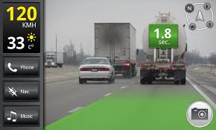
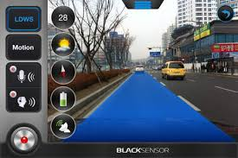
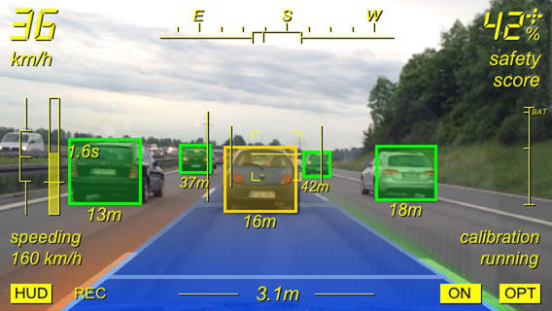
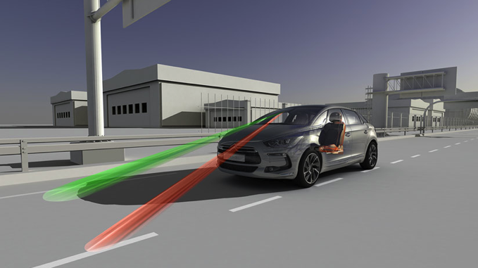
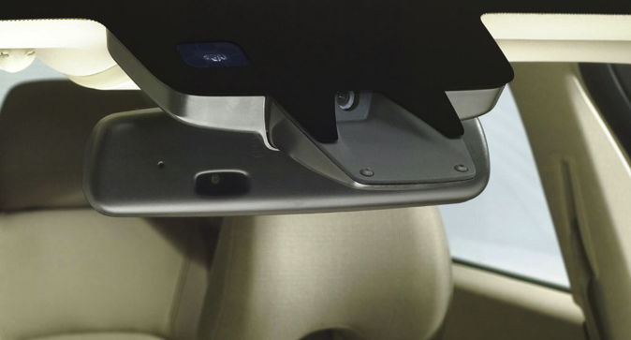
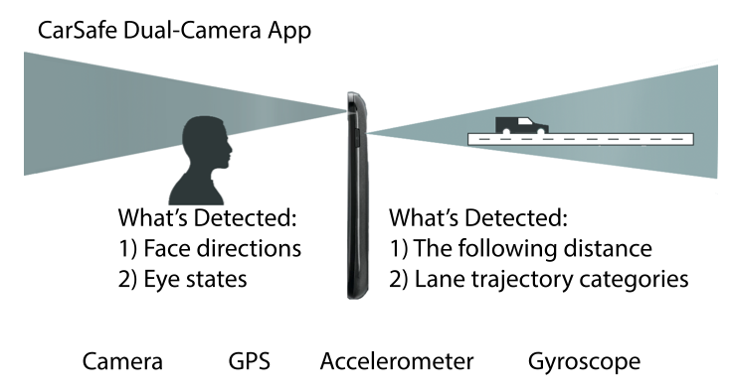
Sole-reliance on Camera
iOnRoad app
BlackSensor app
Augmented Driving app
Citroën DS5 LDW System
Volvo CX90 LDW System
CarSafe app
5

Slide 8
Sole-reliance on Camera
Sense the maneuvers w/o using camera
Our Goal: Reliability!
iOnRoad app
BlackSensor app
Citroën DS5 LDW System
Augmented Driving app
Volvo CX90 LDW System
CarSafe app
5

Slide 9
Signatures in Vehicle Steering
Gyroscope reading in left & right turns
Lane changes
6

Slide 10
Signatures in Vehicle Steering
Left & right turns
Signatures are in the gyroscope reading
How to detect these signatures?
How to classify them?
Lane changes
6

Slide 11
Bump Detection
Bump detection
  No bump → One bump→ Waiting for bump
8
Notes:
----- 会议笔记(4/1/15 16:11) -----
Peak detection. Spend more time on the analytical things.

Slide 12
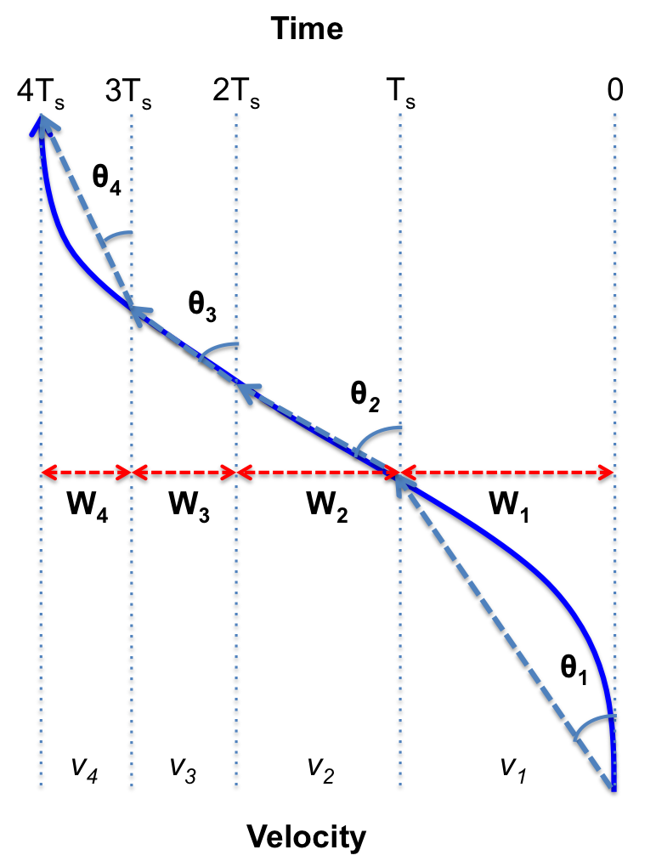
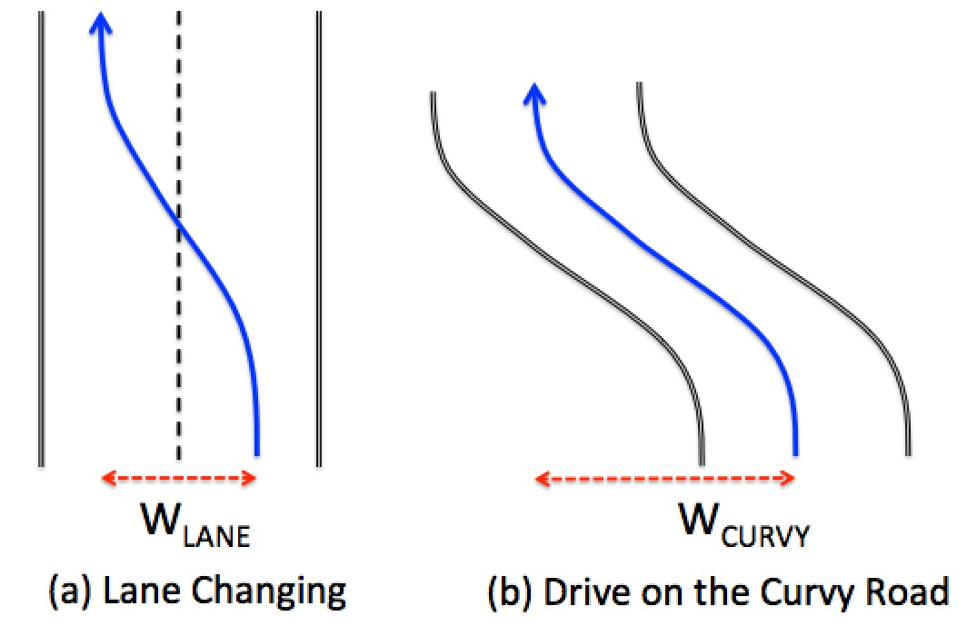
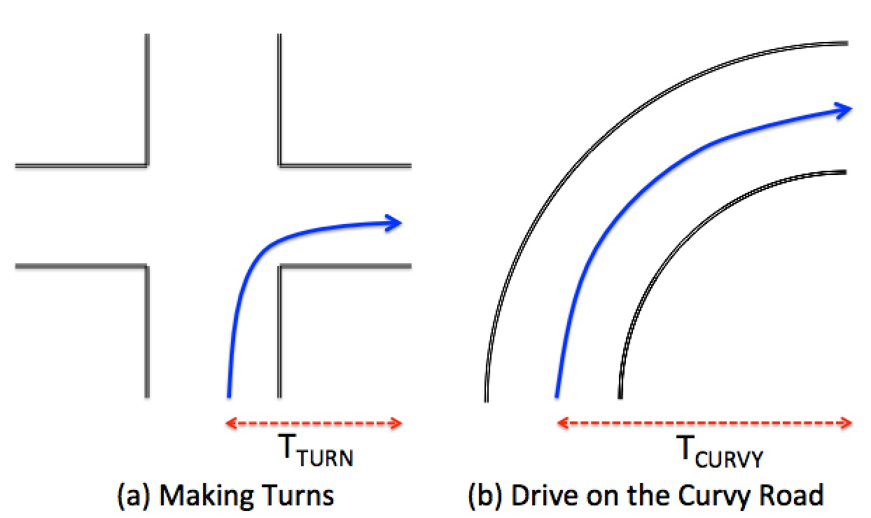
Maneuver Differentiation
Horizontal displacement:
  Integrate horizontal displacement at each reading sample
9

Slide 13
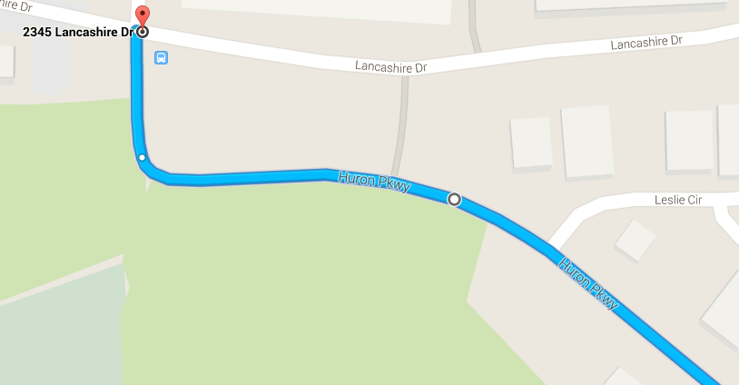
Road Test: Curvy Road
59 m
102 m
10

Slide 14
Road Test: Curvy Road
59 m
102 m
54 m
101.5m
11

Slide 15
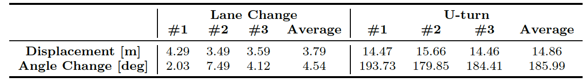
Road Test: Accuracy
12

Slide 16

V-Sense: Highlights
Camera-free
Detect steering maneuvers just using smartphone
Differentiate turning, lane changing, and driving on curvy roads
7
Notes:
----- 会议笔记(4/1/15 15:57) -----
specify which sensors we use. Very diffenrent from existing systems. Nonvision-based. 2nd change with first. This slides is contribution! Move it before! Put demo after this slides. 2) to highlight.

Slide 17




Evaluation
Experiment setup:
  Implemented V-Sense on Samsung Galaxy S4 and S3
  Total 40h test
13

Slide 18
Evaluations: Accuracy
14
Notes:
----- 会议笔记(4/1/15 16:11) -----
1. what could happen if misclassification happens.

Slide 19
Evaluations: Efficiency
15
Notes:
----- 会议笔记(4/1/15 15:57) -----
show bars. S4 is even better than S5.

Slide 20


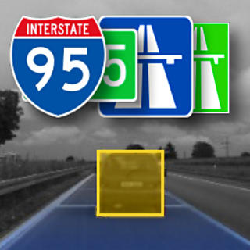

Evaluations: Comparison
~1,000,000
installs
~50,000
installs
110
ratings
~50,000
installs
16
Notes:
----- 会议笔记(4/1/15 15:57) -----
Divde with ground truth.
----- 会议笔记(4/1/15 16:00) -----
parameters are different from previous slides
----- 会议笔记(4/1/15 16:11) -----
mention the evaluation condition. Specify the evaluation scenario. Specify highway, and local road. If you only drive on highway, the performance could be

Slide 21
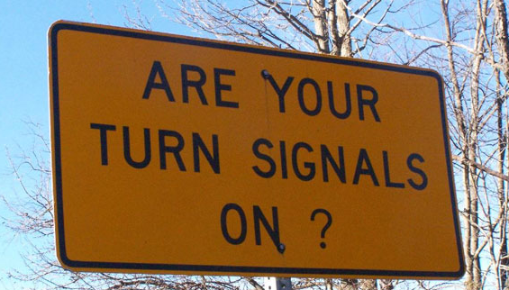
Application I:
Detection of Unintended Steering
16

Slide 22
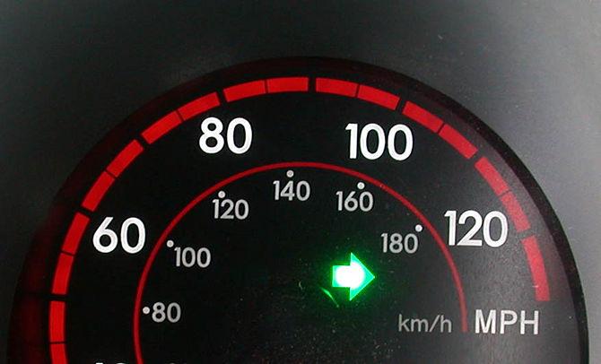
Application I:
Detection of Careless Steering
Instant warning of unintended lane departure
Extract sound from background noise
17
Notes:
----- 会议笔记(4/1/15 16:11) -----
1. Specify the detail;
2. Change to careless.

Slide 23
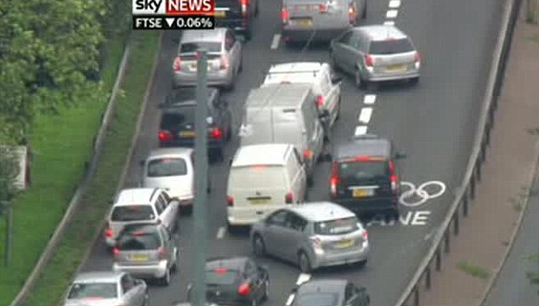
Application II:
Fine-grained Lane Guidance
18

Slide 24
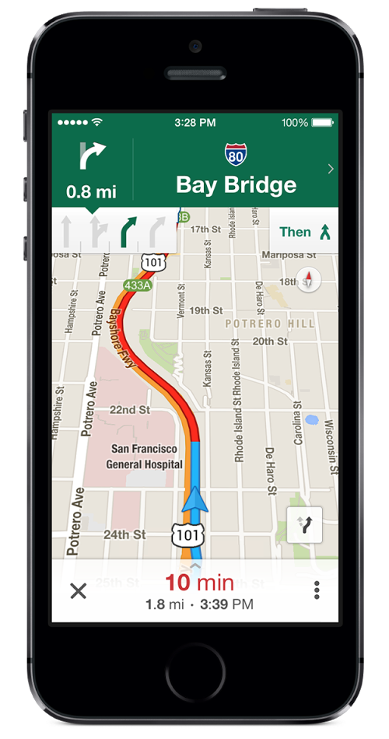
Application II:
Fine-grained Lane Guidance
Instantly know which lane you are driving in
InterHelper
Navigation application
19

Slide 25
Conclusion
Proposed V-Sense, a camera-free steering sensing applications on smartphone
  Differentiate between
    Lane Change
    Left/Right Turn
    U-Turn
    Driving on Curvy Roads
Two proof-of-concept applications
20
Notes:
----- 会议笔记(4/1/15 15:57) -----
ssss!

Slide 26
Thank you
Q&A
21
Notes:
----- 会议笔记(4/1/15 15:57) -----
include email. chendy@umich.edu

