Slide 1

TurnsMap: Enhancing Driving Safety at Intersections with Mobile Crowdsensing and Deep Learning
Dongyao Chen and Kang G. Shin
University of Michigan, Ann Arbor
UbiComp’19, London
Sept. 11th, 2019
Image courtesy: http://onebigphoto.com/intersection-new-york/

Slide 2
Harvesting Crowd’s Driving Pattern
⎯ ◆ ⎯
Every moment, millions of cars are driving on the road
Key question:
Can we exploit crowd for transportation safety?
Notes:
By expanding our perception level

Slide 3
Outline
⎯ ◆ ⎯
1.
Problem
2.
Overview of TurnsMap
3.
Technical Design
4.
Evaluation
5.
Final Remarks

Slide 4


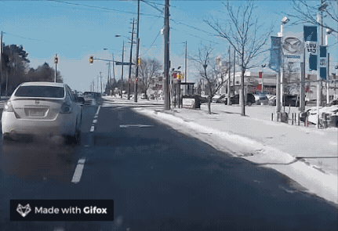
Unprotected Right/Left* Turns are Risky
⎯ ◆ ⎯
Left turns are risky
Protected left turns are reported to be the safest
A real-world problem
53% of all intersection-related crashes are related to left turns
--- U. S. Department of Transportation
Intersection with left-turn protection can reduce the accident rate by 87%
--- NHTSA Report
Notes:
That’s about 480,000 crashes
Bring up ups thing

Slide 5
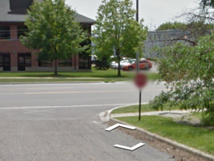
Lack of Publicized Intersection Data
⎯ ◆ ⎯
Left turns are risky
Protected left turns are reported to be the safest
Mapping cars on average take 2 years to update an area
Google StreetView misclassifies stop sign as car plate and blurs it
Lack of publicized data
Government database: Scattered, incomplete (e.g., data.gov, Open Data Portal);
Community-based database: Slowly growing (e.g., OpenStreetMap);
Road survey services: High cost, low-update rate (e.g., Google StreetView, TomTom, Here)
Notes:
Lack of publicized data
Government database: Scattered, incomplete database due to various development level (e.g., data.gov, Open Data Portal)
Community-based database: Slowly growing (e.g., OpenStreetMap)
Road survey services:
High cost, low-update rate (Google Street View, TomTom, Here)

Slide 6

Demand for this Information
⎯ ◆ ⎯
For human drivers
For self-driving cars
Survey result from 567 participants
Have you experienced risky unprotected left turns when you are using navigation apps?
60% said yes!
Handling unprotected left turns is one of the most challenging tasks for self-driving cars.
The Waymo vans have trouble with many unprotected left turns and with merging heavy traffic in the Phoenix area
--- The Information, Aug 28, 2018

Slide 7
Outline
⎯ ◆ ⎯
1.
Problem
2.
Overview of TurnsMap
3.
Technical Design
4.
Evaluation
5.
Final Remarks

Slide 8
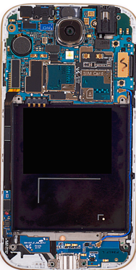
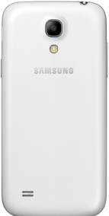
Why Mobile Crowdsensing?
Pros
⎯ ◆ ⎯
Scalability
Low-overhead
High update rate
Cons
⎯ ◆ ⎯
Limited battery life
Poor quality of data
Motion sensors
Gyroscope (angular speed)
Accelerometer
Notes:
Scalability
The worldwide ownership of smartphone has well exceeded 45%
Extreme low-cost
Does not require any extra hardware
High update rate
Can react to changed outdoor environment (e.g., construction, new traffic light/sign)

Slide 9
Infer Left-turn Protection via Sensor Data
⎯ ◆ ⎯
Understanding the root cause of the risk at left turns
Use IMU readings to infer intersection settings
…
Interruptions due to the oncoming traffic and/or crossing pedestrians
Key idea: Use crowdsensed IMU sensor readings to infer intersection settings

Slide 10
System Overview
⎯ ◆ ⎯
Data collection
Finding left turn hotspots
Classification based on machine learning
Data collection
Data mining
Machine learning
Discovering left-turn hotspots
Classification of left turns
Results
Protection schemes at left turns
···
Notes:
We achieved this idea by using a systematic approach

Slide 11
Outline
⎯ ◆ ⎯
1.
Problem
2.
Overview of TurnsMap
3.
Technical Design
4.
Evaluation
5.
Final Remarks

Slide 12
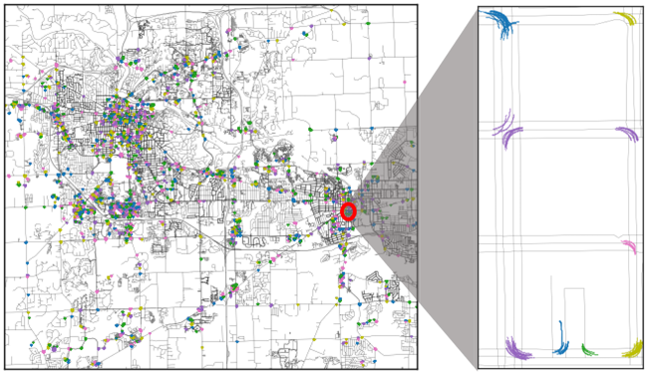
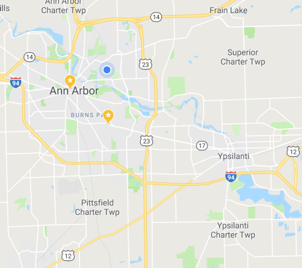
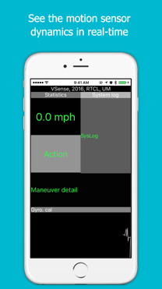
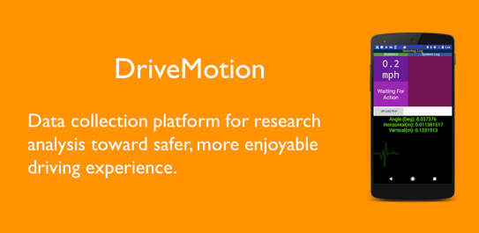
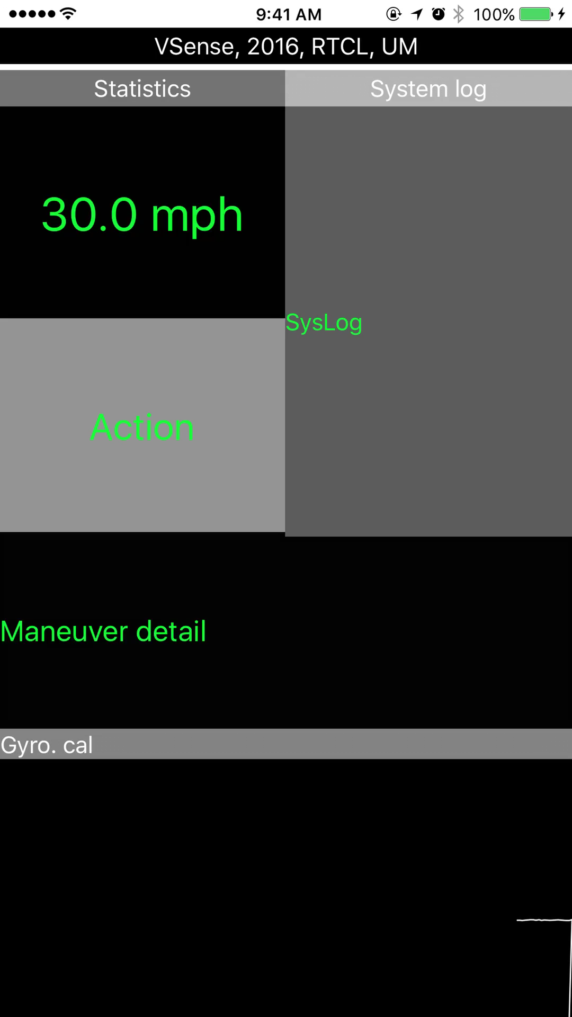





Collection and Discovery of Left Turn Hotspots
Gyroscope, accelerometer, and GPS
Do they belong to the same left turn maneuver?
Framing data snippets that contain left turns
$${start}_{1}$$
$${end}_{1}$$
$${start}_{2}$$
$${end}_{2}$$
Notes:
We answered a tricky question: due to interruption,

Slide 13
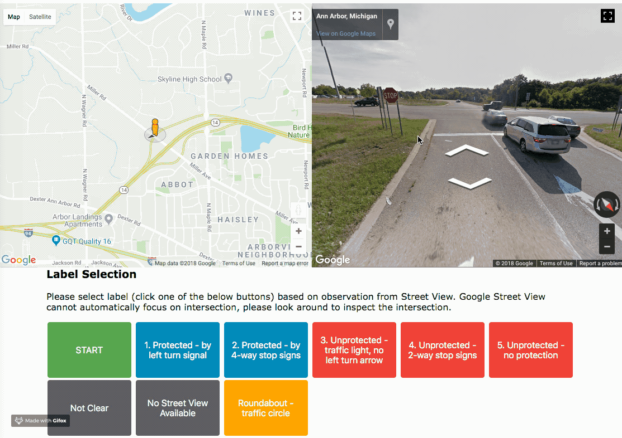
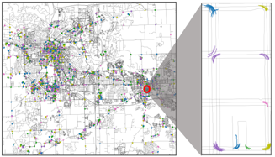
Finding Ground Truth
Outsourcing labeling tasks via Amazon Mechanical Turk
Recruited 231 workers
6,016 annotations, 5.47 labels / hotspot
Map View
StreetView
Opt. | Description
1 | Traffic light - protected
2 | Stop sign – all-way
3 | Traffic light - regular
4 | Stop sign – two-way
5 | Unprotected
6 | None of the above
Label options
Interactive labeling system design
Notes:
Why we use Google maps
Why we collect redundant labels: people have different perception level

Slide 14
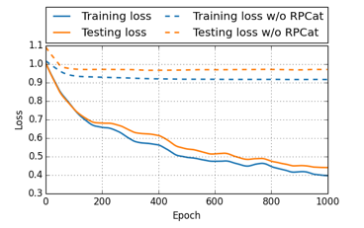
Understanding Statistical Features with Machine Learning
Labels
Observations from hotspots
Data Augmentation
Supervised learning
Result
Expand the size of time-series observations
Recurrent neural network
Data augmentation
Achieve 10x larger observations for training!
Long- and short-term memory (LSTM) algorithm captures the dependency through time

Slide 15
Outline
⎯ ◆ ⎯
1.
Problem
2.
Overview of TurnsMap
3.
Technical Design
4.
Evaluation
5.
Final Remarks

Slide 16
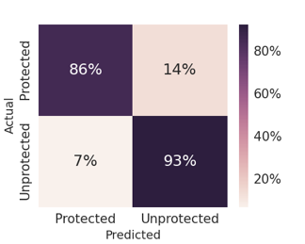
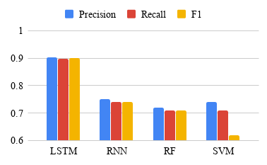
Classification Accuracy
⎯ ◆ ⎯
Evaluation metrics
Compare LSTM with other machine learning algorithms
Category | Precision | Recall | F-1
Protected | 0.90 | 0.86 | 0.88
Unprotected | 0.91 | 0.93 | 0.92

Slide 17
Overhead of the Data Collection App
⎯ ◆ ⎯
CPU usage
Battery usage
TurnsMap on average uses 45 mA --- only 6% of Google Maps’ power consumption

Slide 18
Outline
⎯ ◆ ⎯
1.
Problem
2.
Overview of TurnsMap
3.
Technical Design
4.
Evaluation
5.
Final Remarks

Slide 19
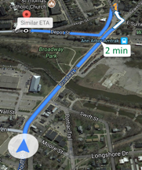
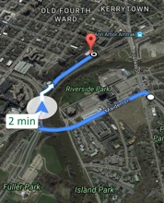

Use Case
⎯ ◆ ⎯
Adapting TurnsMap for Navigation Systems
User study of 564 participants
Two unprotected left turns
Replace unprotected left turns with right turns by altering trip route
I will use it if it has similar ETA
Would you prefer a navigation app that can help you avoid unprotected left turns?
I’ll use even with a prolonged ETA
Notes:
Travel from point A to point B
Can acheive win-win collaboration

Slide 20
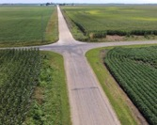
Analyze Intersections, Worldwide
Intersection w/o traffic light/sign
Remote region
Crowded road
Rough road condition
Unprotected intersection is a common problem and shares the same nature across the world
Future work: how to adapt to the local driving pattern
Notes:
TurnsMap can extract the interruption feature and identify intersections where left turns have high possibility to be interrupted.
Navigation systems can use this information and help the drivers avoid left turns at such intersections.
We reveal this information, how to use it is left to the user and app developer to decide

Slide 21
Thank You!
⎯ ◆ ⎯
Q & A

