Slide 1
Locating and Tracking BLE Beacons with Smartphone
Dongyao Chen, Kang G. Shin, Yurong Jiang, and Kyu-Han Kim
Seoul/Incheon, South Korea
December 14, 2017

Slide 2
Background: BLE Beacon
BLE beacon: a class of BLE devices that broadcast their IDs to nearby devices
Light-weighted, low-power design (2-year battery life)
Main usage scenario: measuring proximity in a retailor store
Estimated market of $52B by year 2020
[1] http://www.businessinsider.com/google-looks-to-secure-bluetooth-beacon-communications-2016-4

Slide 3
Background: Proximity Sensing App
Broadcast periodically
Preamble (9 B)
UUID (16 B)
Major (2 B)
Minor (2 B)
TX (1 B)
30 Bytes
Band pass filter
AGC
AMP
DSP back end
BLE signal
Mixer
Analog front end
RSS reading
User’s smartphone can estimate the proximity of neighboring BLE beacons by analyzing RSS

Slide 4
Background: Proximity Sensing App
Immediate
Near
Far
User’s smartphone can estimate the proximity of neighboring BLE beacons by analyzing RSS
Provide rough proximity information of surrounding beacons
E.g., immediate, near, and far

Slide 5



Background: Proximity Sensing App
Legacy Proximity Application…
LocBLE
YOUR ITEM IS “NEAR” !
YOUR ITEM’s POSITION IS ($\tilde{x},\tilde{y}$) !!
$$(x, y)$$
$$(x, y)$$
I
II
User’s smartphone can estimate the proximity of neighboring BLE beacons by analyzing RSS
Provide rough proximity information of surrounding beacons
E.g., immediate, near, and far
Usability is limited – only proximity information is provided

Slide 6
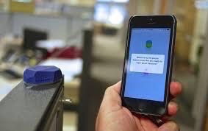

Benefits from Estimating Beacons’ Location
Interested item
Find item
Highlight item in AR
Infer user’s relative location
“Last meter” navigation
Use-cases
Locate lost item(s)
Highlight interested item(s) in AR
Infer user’s relative location
“Last meter” navigation: fine-grained localization for augmenting GPS navigation

Slide 7
Locating BLE Beacons – why it’s Challenging?
v. s.
AC powered RF transmitter
< 500 mA·h battery designed for 3-year lifetime
Bandwidth: 40 MHz for 802.11 n
Bandwidth for BLE signal 2 MHz ea. sub-channel
Connectivity: both send and receive
Connectivity: only send
Constraints stem from the nature of BLE beacon signal
Limited transmission power – for sustaining years of usage
Narrow bandwidth – only 2 MHz bandwidth for each sub-channel
Limited connectivity – only capable of sensing BLE advertisements

Slide 8
Goal: Locating BLE Beacon on Smartphones
LocBLE
Smartphone-based application for estimating location of nearby commodity BLE beacons

Slide 9
Goal: Locating BLE Beacon on Smartphones
LocBLE
RSS data preprocessing
RSS + IMU
sensor fusion
Beacon clustering
Smartphone-based application for estimating location of nearby commodity BLE beacons
3 key modules

Slide 10



I: Mitigate RSS Signal Fluctuation
RSS – distance (path loss) model:
Estimate path loss exponent and path loss offsets
Path loss exponent – varies with environment
Path loss offsets – vary with environment and hardware configuration(s)
$$RSS=Γ−10nlog\left(d\right)$$
$n$
$$Γ$$
Notes:
Here we use the Log distance path loss model
First takeaway is RSS data is noisy. The noise comes two factors from the rayleigh fading model
U$nknown variables:Gamma and n$
Different models of Bluetooth device will cause drift of distance estimation
PL(d0)PL(d0) = Path Loss in dBdB at a distance d0d0 PLd>d0PLd>d0= Path Loss in dBdB at an arbitrary distance dd nn = Path Loss exponent. See the table below that gives the path loss exponent for various environments. χχ = A zero-mean Gaussian distributed random variable (in dBdB) with standard deviation – σσ. This variable is used only when there is a shadowing effect. If there is no shadowing effect, then this variable is zero. Taking log of the Normal (Gaussian)-variable results in the name “Log-Normal” fading.

Slide 11

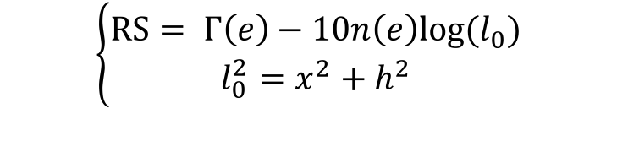









II. RSS + IMU Sensor Fusion
$$(x,h)$$
BLE beacon
Observer
$$l_{0}$$
$$l_{1}$$
$$l_{2}$$
$$…$$
$$l_{N}$$
$$(0,0)$$
$$(a_{1},c_{1})$$
$$(a_{2},c_{2})$$
$$(a_{N},c_{N})$$
Problem formulation: RSS reading + user’s movement
Measured by BLE receiver
$$\left\{\begin{aligned}RS= Γ\left(e\right)−10n\left(e\right)log⁡(l_{0}) \\ l_{0}^{2}=x^{2}+h^{2}\end{aligned}\right.$$
Estimate target

Slide 12

II. RSS + IMU Sensor Fusion
$$(x,h)$$
BLE beacon
Observer
$$l_{0}$$
$$l_{1}$$
$$l_{2}$$
$$…$$
$$l_{N}$$
$$(0,0)$$
$$(a_{1},c_{1})$$
$$(a_{2},c_{2})$$
$$(a_{N},c_{N})$$
Problem formulation: RSS reading + user’s movement
Measured by BLE receiver
$$\left\{\begin{aligned}RS= Γ\left(e\right)−10n\left(e\right)log⁡(l_{0}) \\ l_{0}^{2}=x^{2}+h^{2}\end{aligned}\right.$$
$$l_{i}^{2}={(x−a_{i})}^{2}+{(h{−c}_{i})}^{2}$$
Estimate target
Measured by IMU sensor

Slide 13
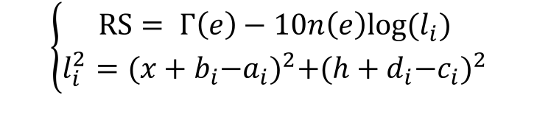
II. RSS + IMU Sensor Fusion
$$(x,h)$$
BLE beacon
Observer
$$l_{0}$$
$$l_{1}$$
$$l_{2}$$
$$…$$
$$l_{N}$$
$$(0,0)$$
$$(a_{1},c_{1})$$
$$(a_{2},c_{2})$$
$$(a_{N},c_{N})$$
Problem formulation: RSS reading + user’s movement
$$\left\{\begin{aligned}RS= Γ\left(e\right)−10n\left(e\right)log⁡(l_{i}) \\ l_{i}^{2}={(x+b_{i}{−a}_{i})}^{2}+{(h+d_{i}{−c}_{i})}^{2}\end{aligned}\right.$$
Measured by observer’s/target’s IMU sensor
Notes:
Motivated by triangulation.
Specifically, users

Slide 14
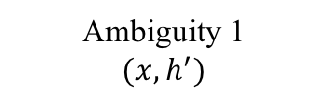
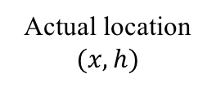
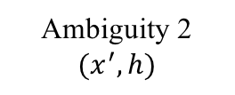
II. RSS + IMU Sensor Fusion
BLE Beacon
Ambiguity 1
$$(x,h^{′})$$
A
B
BLE Beacon
BLE Beacon
Actual location
$$(x,h)$$
C
Ambiguity 2
$$(x^{′},h)$$
“L-shaped” movement process
Resolve symmetric issue
Accumulate enough data for sensor fusion

Slide 15
III. Clustering Algorithm
Far-fetch beacons
Neighboring beacons
Refine estimation results by leveraging neighboring beacons
Clustering
Formulate cluster based on dynamic time warping (DTW) distance
Notes:
Our goal here is not for separating beacons.
People may misunderstand that, say two bus stop signs are close to each other

Slide 16
Evaluation
Implementation:
LocBLE on both Android and iOS platforms
Tested on iBeacon protocol
9 experimental environments
Notes:
remove 7, 8, 9

Slide 17

Evaluation
$$LocBLE abs. = \sqrt{x_{est}^{2}+h_{est}^{2}}$$
Estimating stationary beacons’ locations
Notes:
xlabel
explain x and h are coordinates

Slide 18
Evaluation
Changing RSS sampling frequency
Varying length of data trace for location estimation
Notes:
Explain CDF
Explain length of data trace, extimation error is x & h

Slide 19
Evaluation
Clustering Performance: estimations from neighboring devices mitigate the impact of noisy RSS readings

Slide 20
Conclusion
LocBLE
Smartphone-based application for estimating location of nearby commodity BLE beacons
3 key components for extracting location information
RSS signal preprocessing
RSS + IMU sensor fusion
Clustering
Achieved ~2 m localization accuracy in various environment

Slide 21
Thank you
Q & A
Ugh, I lost MY ble headset! have to use wired earbuds again!
Find it with locble!
Comic credit: Rich Stevens @ imore.com

Slide 22
References
Dongyao Chen, Kyong-Tak Cho, Sihui Han, Zhizhuo Jin, and Kang G. Shin. Invisible Sensing of Vehicle Steering with Smartphones. In ACM MobiSys, 2015.
Nirupam Roy, He Wang, and Romit Roy Choudhury. I am a Smartphone and I can Tell my User’s Walking Direction. In ACM MobiSys, 2014.
Souvik Sen,Jeongkeun Lee,Kyu-Han Kim,and Paul Congdon. Avoiding Multipath to Revive Inbuilding WiFi Localization. In ACM MobiSys, 2013.
Yuanchao Shu, Kang G Shin, Tian He, and Jiming Chen. Last-mile Navigation Using Smartphones. In ACM MobiCom, 2015.
P. Bahl and V. N. Padmanabhan. Radar: an In-building RF-based User Location and Tracking System. In IEEE INFOCOM, 2000
Bluetooth 5.0 Core Specication, transmitter characteristics, page 2536. https://www.bluetooth.com/speci cations/adopted-specications.

Slide 23
Backup slides

Slide 24
Measurement Pipeline of LocBLE
Magnetometer
Motion tracker
Data fusion
Estimation result
Motion Sensor
Noise filtering
BLE Scanner
Environment analysis
Preprocess RSS
Regression-based sensor fusion

Slide 25
Discussion
LocBLE
LocBLE enables BLE beacon localization at low cost

Slide 26
Backup slides

Slide 27
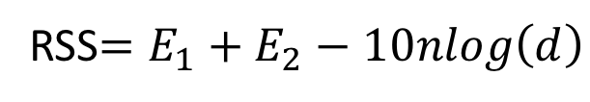
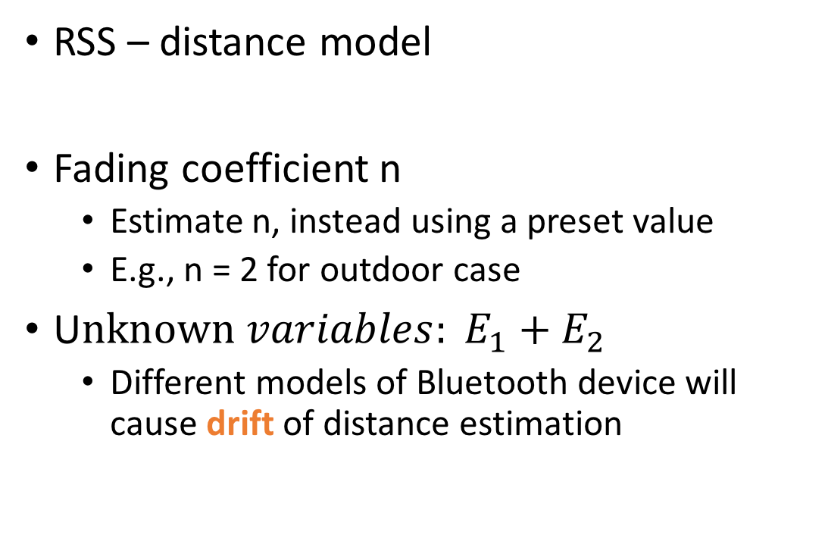
Using RSS Signal for Sensing Location
RSS – distance model
Fading coefficient n
Estimate n, instead using a preset value
E.g., n = 2 for outdoor case
U$nknown variables: E_{1}+E_{2}$
Different models of Bluetooth device will cause drift of distance estimation
RSS$=E_{1}+E_{2}−10nlog\left(d\right)$

Slide 28

Legacy Proximity Application…
With LocBLE
YOUR ITEM IS “NEAR” !
YOUR ITEM’s POSITION IS ($\tilde{x},\tilde{y}$) !!
$$(x, y)$$
$$(x, y)$$
I
II

Slide 29
Data collection layer
Location estimation layer
Calibration layer
Motion Sensor
Motion tracker
Is target moving?
Magnetometer
Noise filtering
Nodes clustering
Data fusion
BLE Scanner
EnvAware
Adaptive calibration

